Slide 1
PROJECT PROPOSAL FOOD ORDER SYSTEM
TASNOVA TASNIM
ID:UG02-47-18-012
EMAIL:tasnimprity12@gmail.com

Slide 2
WELCOME
FOOD ORDER SYSTEM

Slide 3
Abstract
 ONLINE FOOD DELIVERY SYSTEM is a website designed primarily for use in the food delivery industry. This system will allow hotels and restaurants to increase scope of business by reducing the labor cost involved. The system also allows to quickly and easily manage an online menu which customers can browse and use to place orders with just few clicks. Restaurant employees then use these orders through an easy to navigate graphical interface for efficient processing.

Slide 4
Introduction
Online ordering system that I am proposing here, greatly simplifies the ordering process for both the customer and the restaurant. System presents an interactive and up-to-date menu with all available options in an easy to use manner. Customer can choose one or more items to place an order which will land in the Cart. Customer can view all the order details in the cart before checking out. At the end, customer gets order confirmation details. Once the order is placed it is entered in the database and retrieved in pretty much real time. This allows Restaurant Employees to quickly go through the orders as they are received and process all orders efficiently and effectively with minimal delays and confusion

Slide 5
Objective
Develop a system that will allow customers to place their food order online and provide them with feedback as to the calorie and fat count of the meal, a generic image of the meal, a list of side dishes, main course ingredients, and cost information

Slide 6
What To Do
provide a display that will allow the customer to choose menu items and make corrections.
 update this display with changes to the order
.  provide a running total cost and calorie/fat count.
 At order finalization, we will request identification information from the customer.
 offer a static map of our surrounding area so that customers unfamiliar with our location can find us.

Slide 7


Slide 8
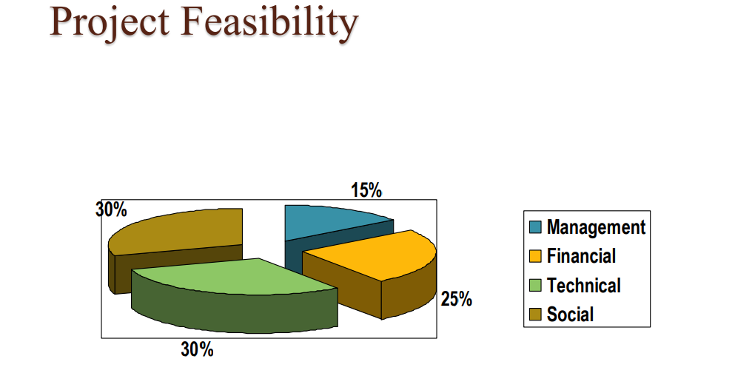

Slide 9
Implementation
Hardware Interface:
• Pentium Processor
• 60 MB of free hard-drive space
• 128 MB of RAM Software Interface:
• Operating System: Windows (Vista/7 or above)
• Web Browser: IE 10 or above, Mozilla FF 31 and above or Google Chrome
 Xampp platform

Slide 10
MODULES
Admin
User Module
Contact Us Module
Search Module

Slide 11
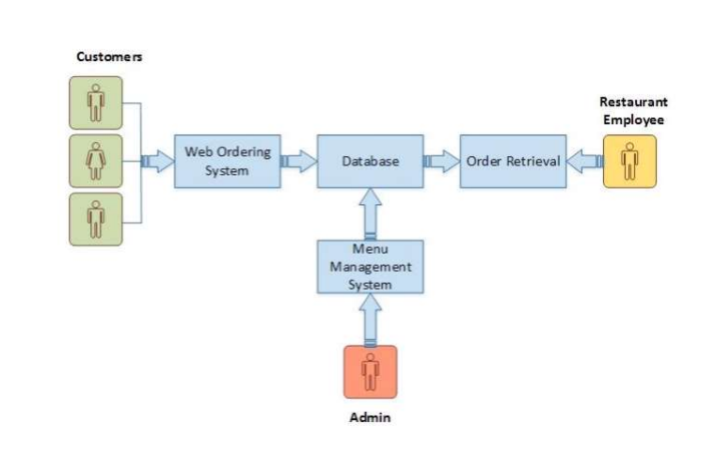
Program Requirements

Slide 12
Web Ordering System Module
 Create an account.
• Manage their account.
• Log in to the system.
• Select an item from the menu.
• Add an item to their current order.
• Review their current order.
• Remove an item/remove all items from their current order.
• Provide payment details.
• Place an order.
• Receive confirmation in the form of an order number.
• View order placed.

Slide 13
Menu Management System Module
 Add/update/delete food category to/from the menu.
• Add /update/delete food item to/from the menu.
• Update price for a given food item.
• Update additional information (description, photo, etc.) for a given food item.

Slide 14
Order Retrieval System Module
This is the most simplest module out of all 3 modules. It is designed to be used only by restaurant employees, and provides the following functions:
Retrieve new orders from the database.
• Display the orders in an easily readable, graphical way.

Slide 15
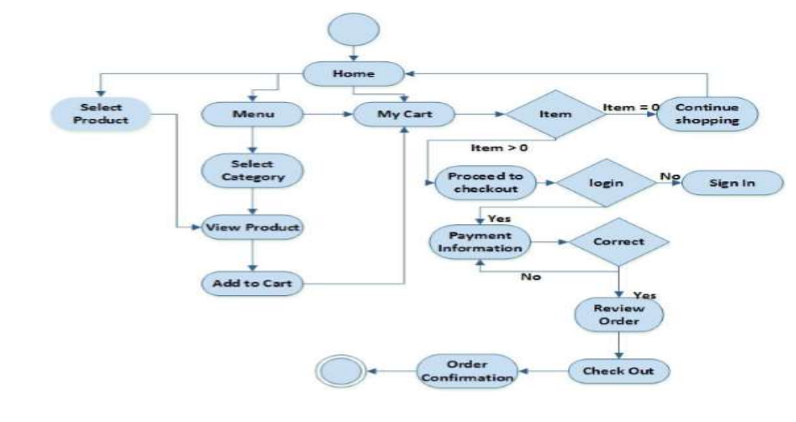
Activity Diagram

